Slide 1


Informatica Data Quality Parser Transformation Lab

Slide 2
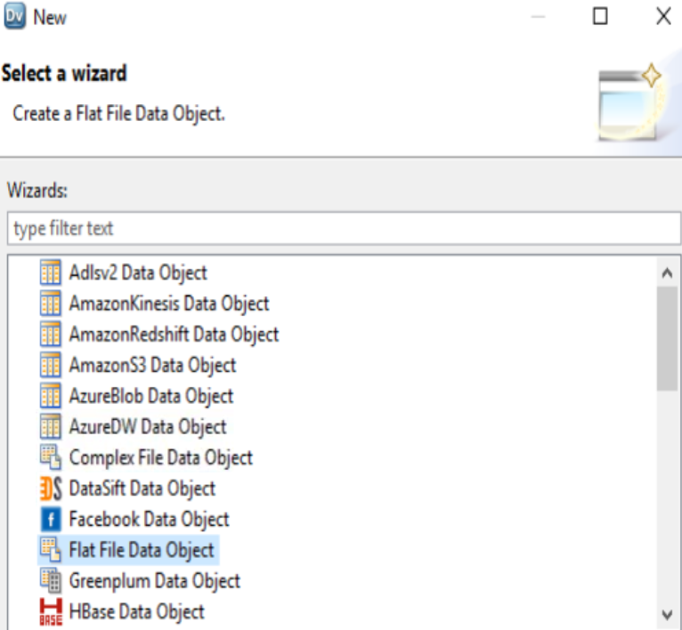
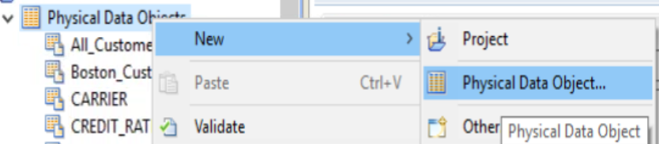
Step 1 : Create New Physical Data Objects
Name : Customer_info.txt Delimited = Comma First Line Column Name => True Text Qualifier ➔ Double Quotes

Slide 3
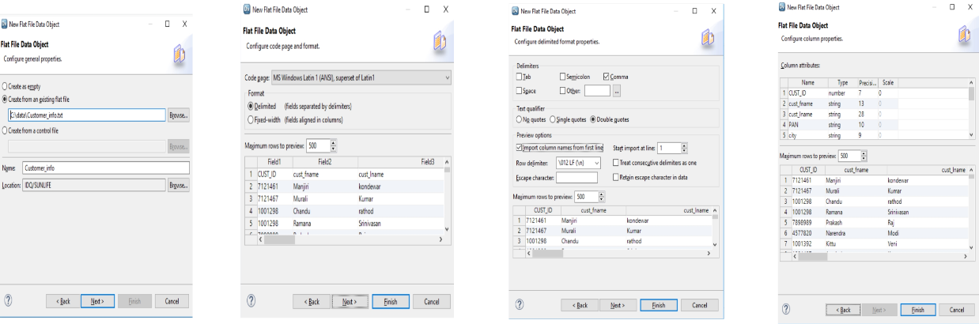
Step 1 : Create New Physical Data Objects
Name : Customer_info.txt Delimited = Comma First Line Column Name => True Text Qualifier ➔ Double Quotes

Slide 4
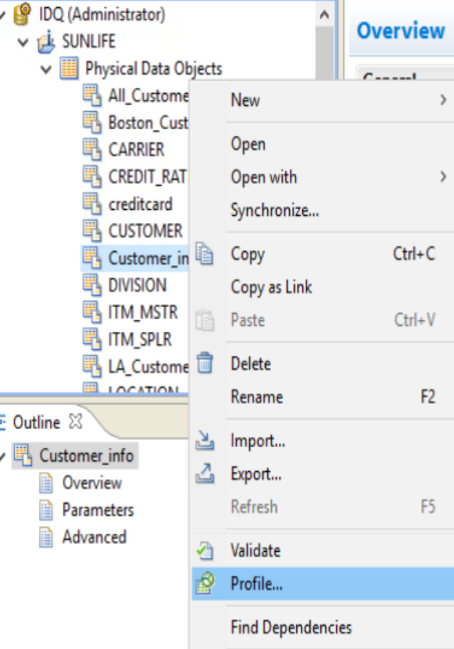
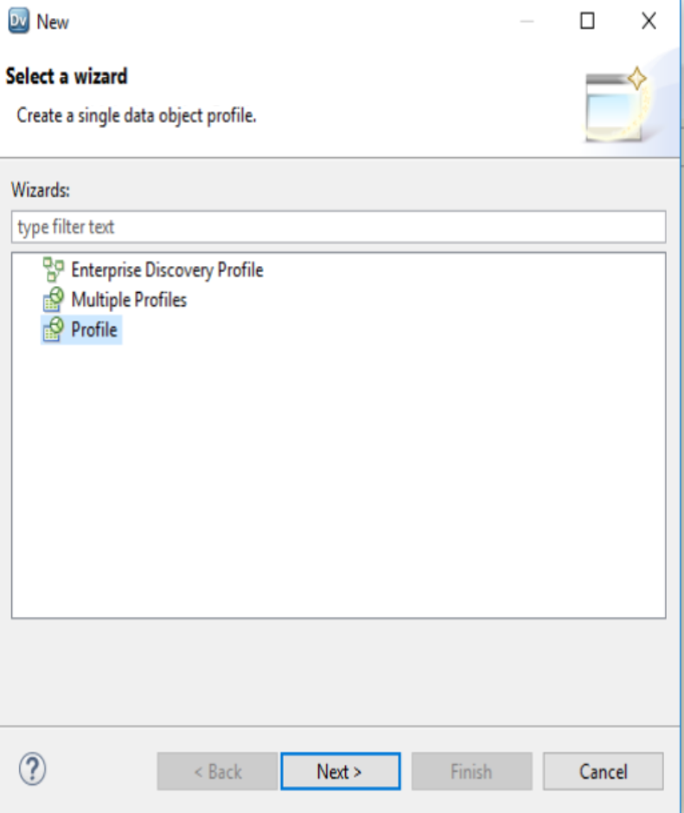
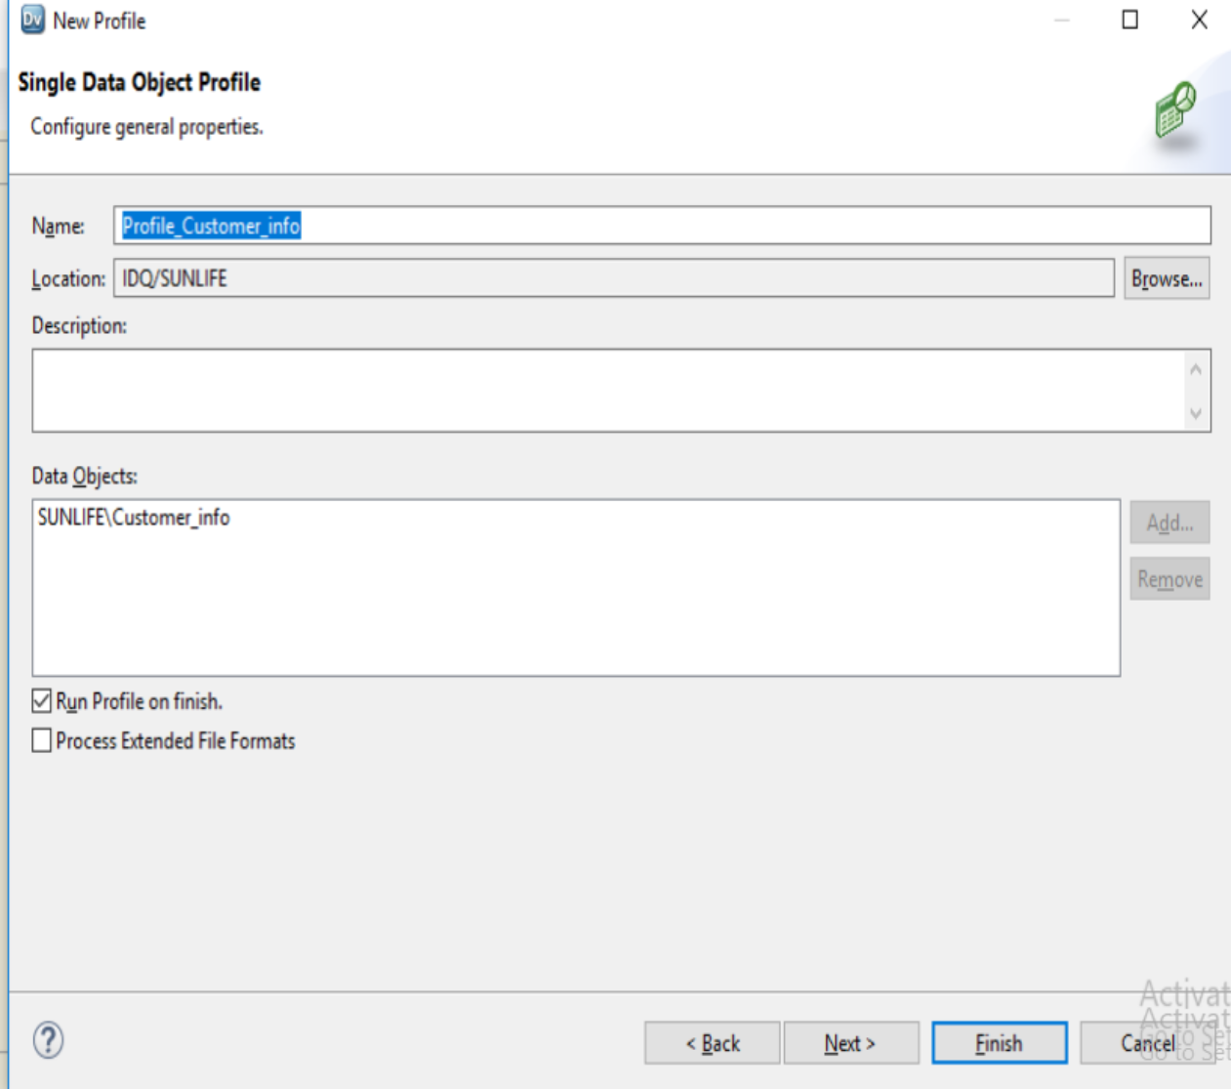
Step 2 : Perform Data Profiling ➔ Customer_info

Slide 5
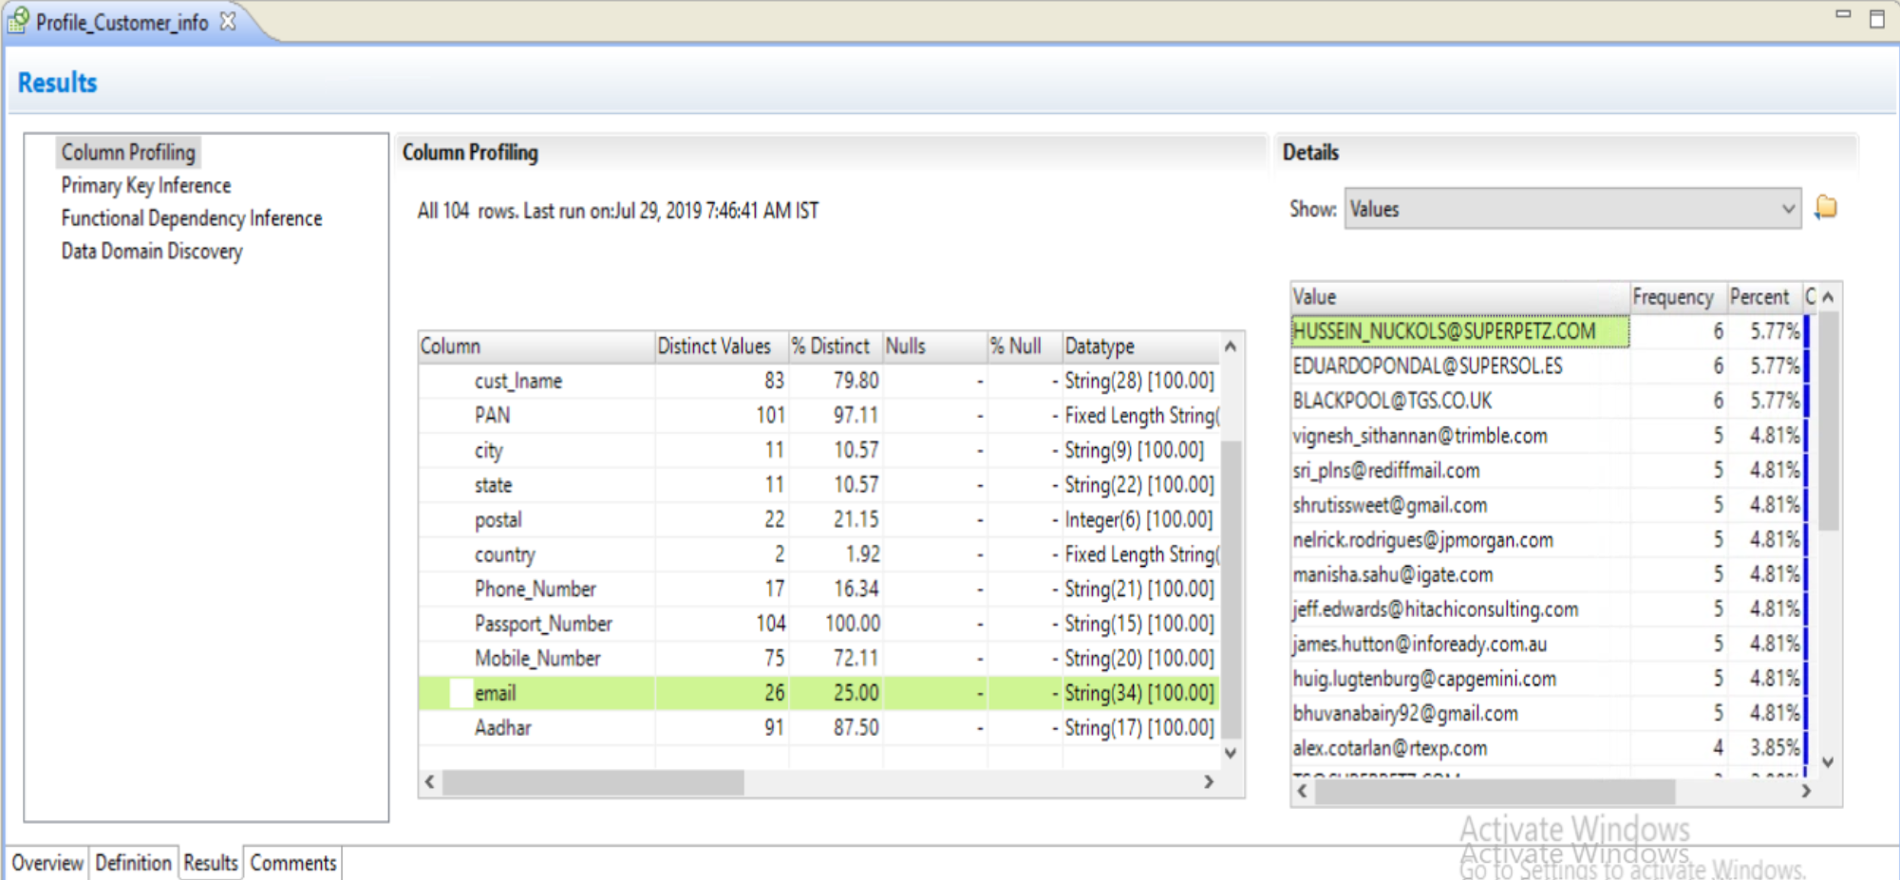
Step 3 : Analyze Data Profiling Result ➔ Customer_info and Analyze Email Column , Understand Pattern
Email Column ➔ Name + Company + Domain

Slide 6
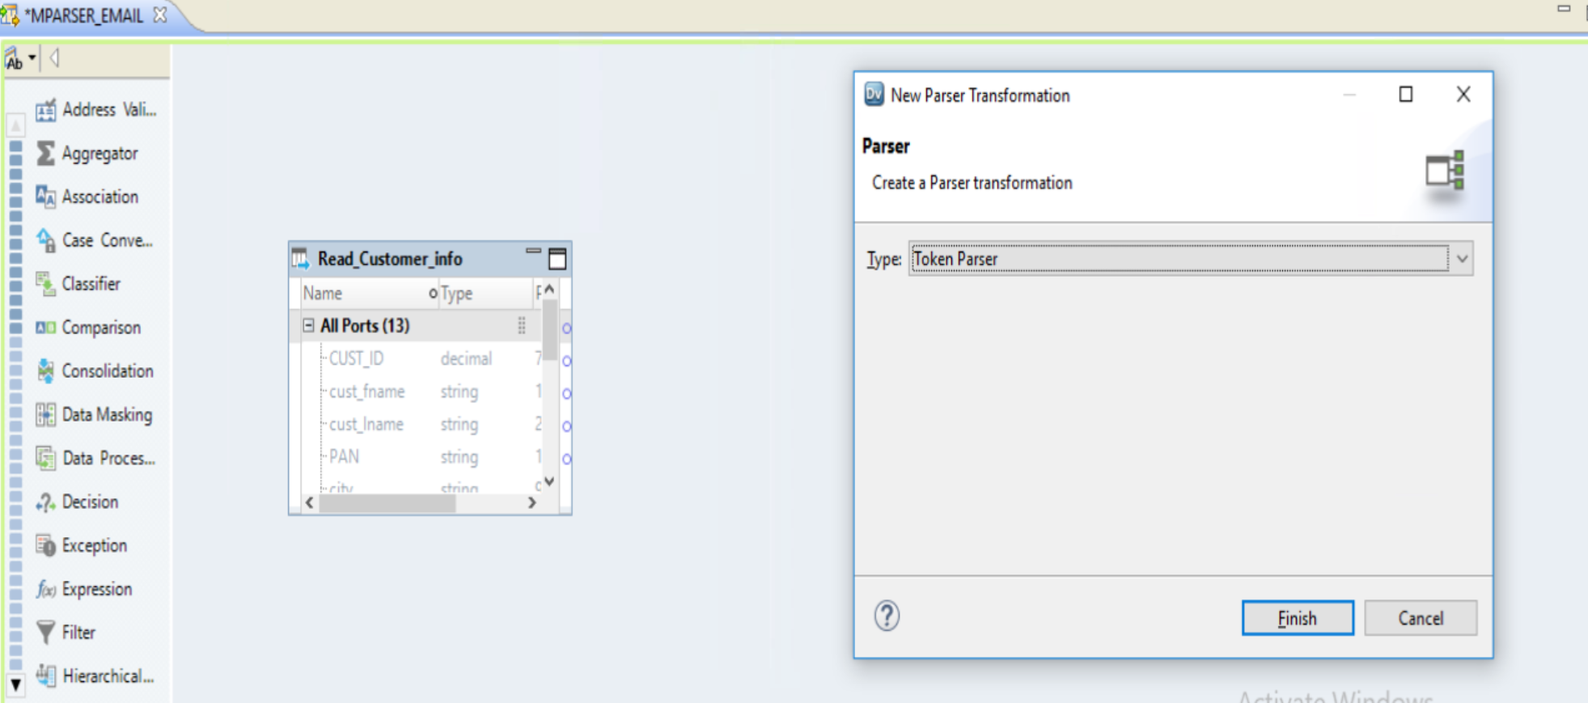
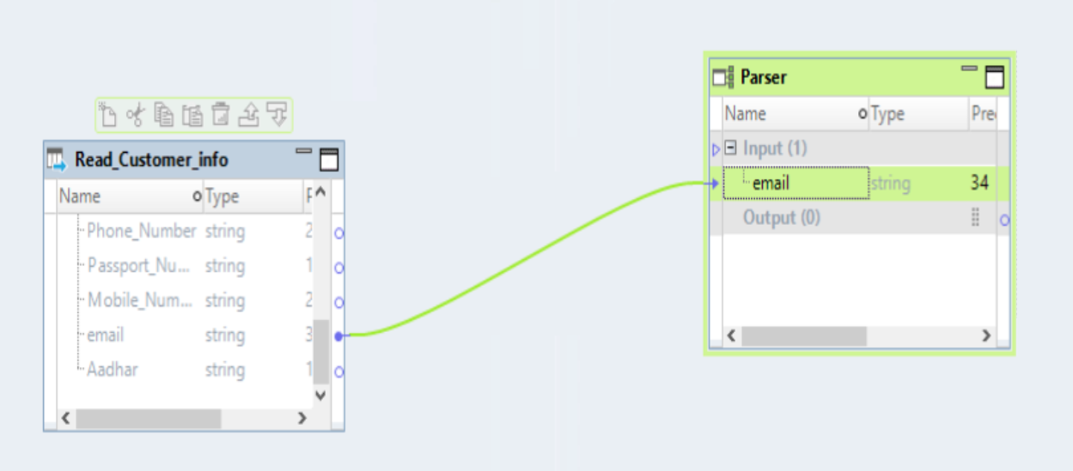
Step 4 : Create New Mapping ➔ M_PARSER_EMAIL
A . ADD SOURCE ➔ Customer_info (read)
B. Add Transformation (Parser)
Choose TOKEN PARSER
Drag Email Column From and Link to Input in PARSER Transformation

Slide 7
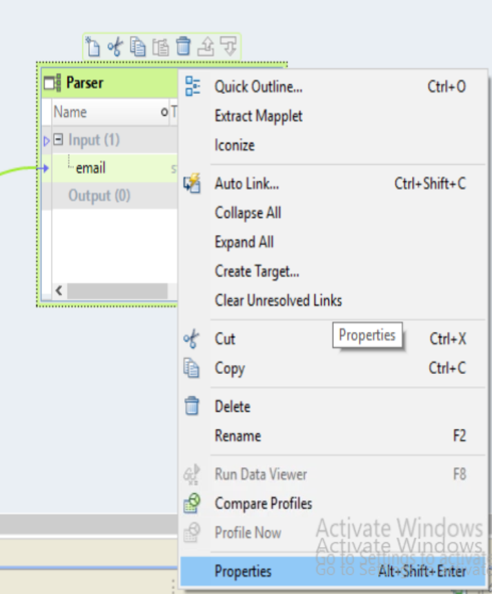
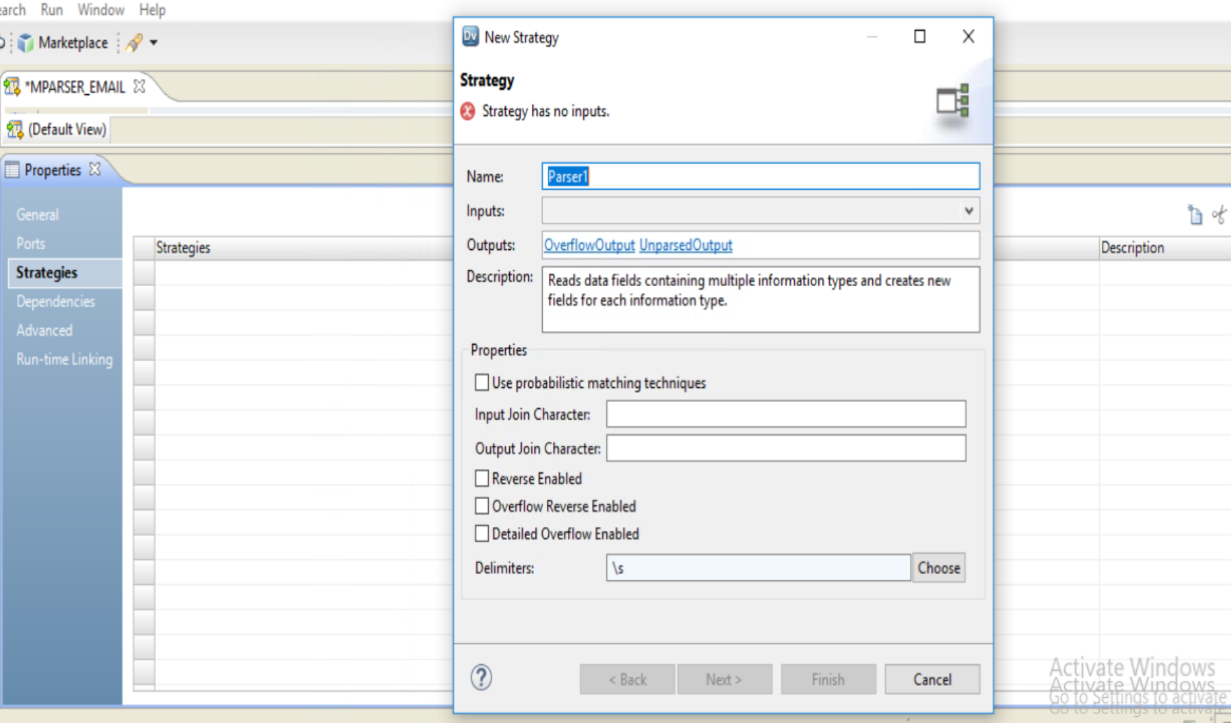
Step 4 : Configure PARSER TRANSFORMATION
A . Choose Properties
B . Strategies ➔ new Strategy

Slide 8
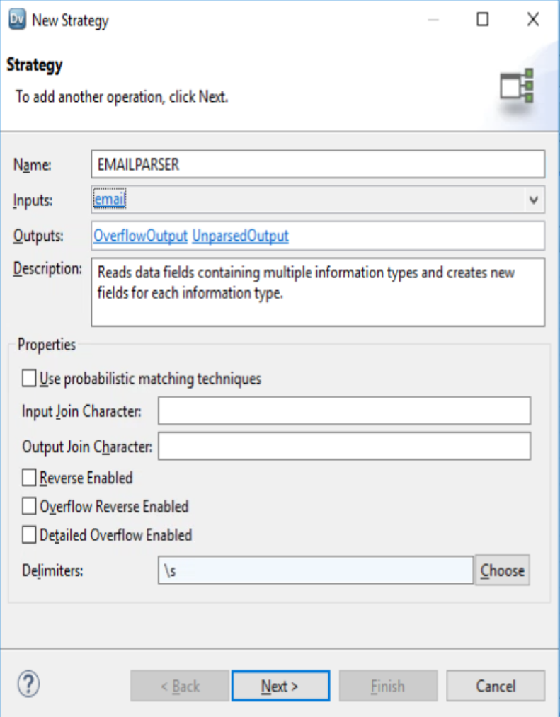
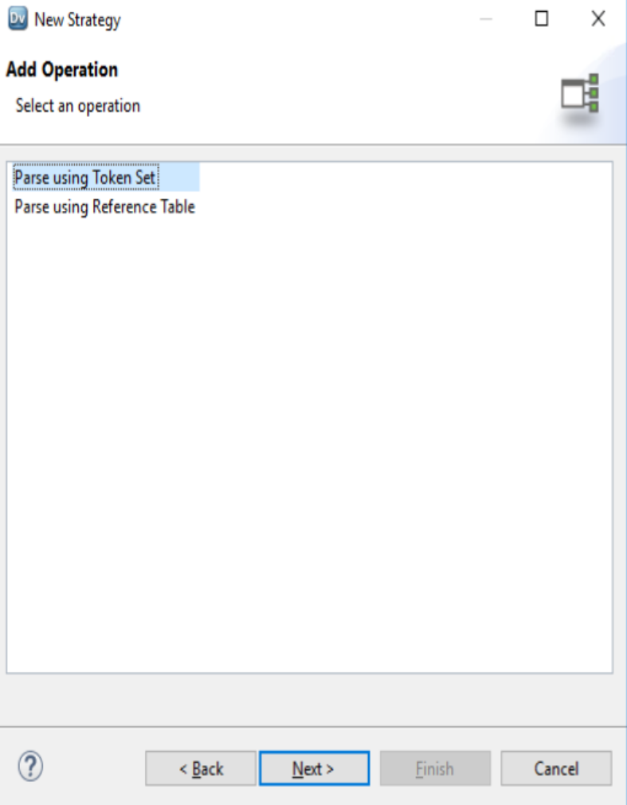
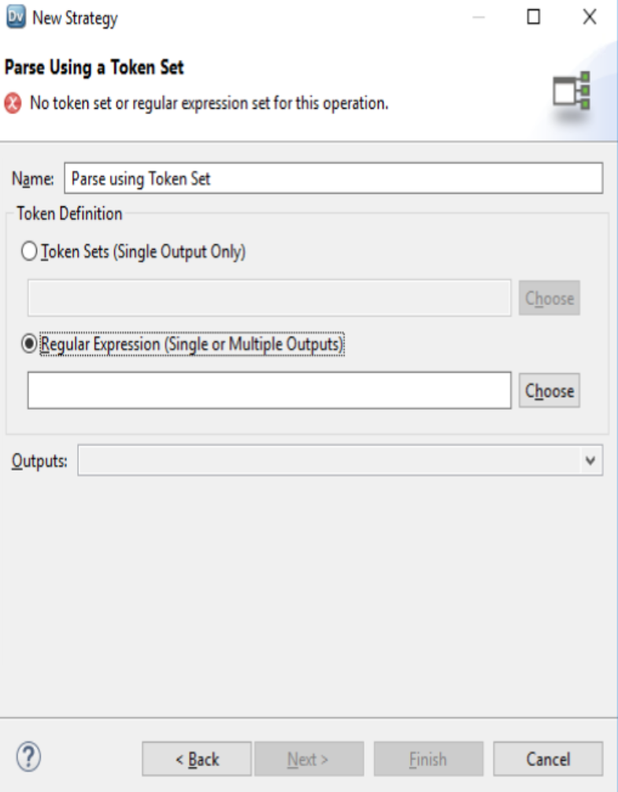
Step 4 : Configure PARSER TRANSFORMATION
A . Name ➔ EMAILPARSER
B. INPUT ➔ EMAIL
C. ADD OPERATION ➔ Parser using TOKEN Set
D. Parser using TOKEN Set ➔ Regular Expression

Slide 9
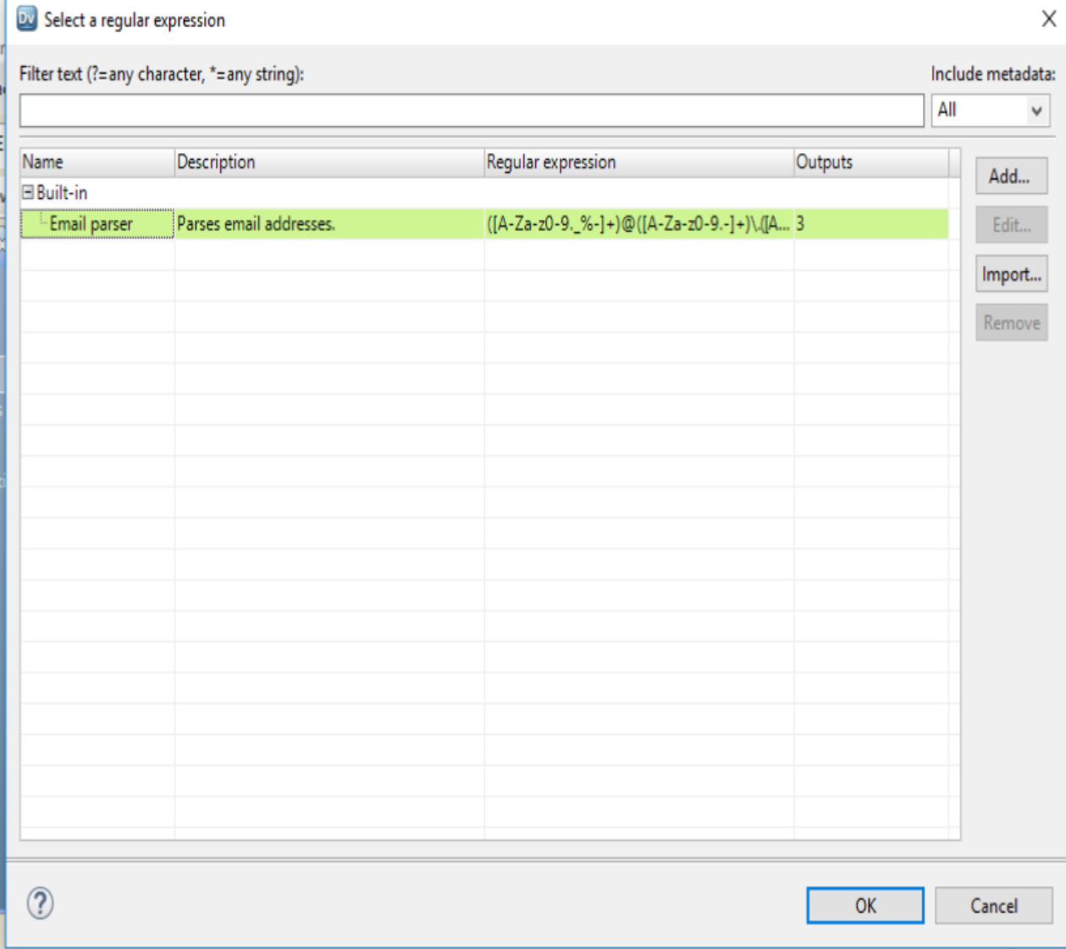
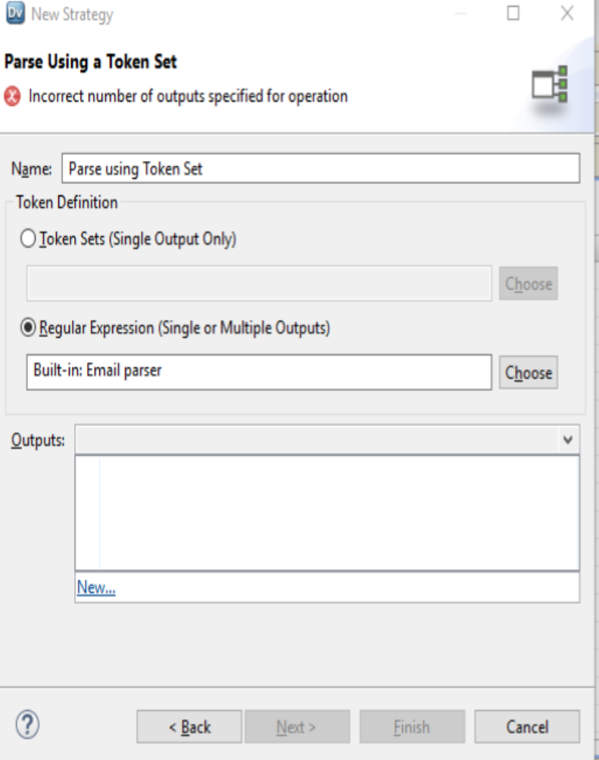
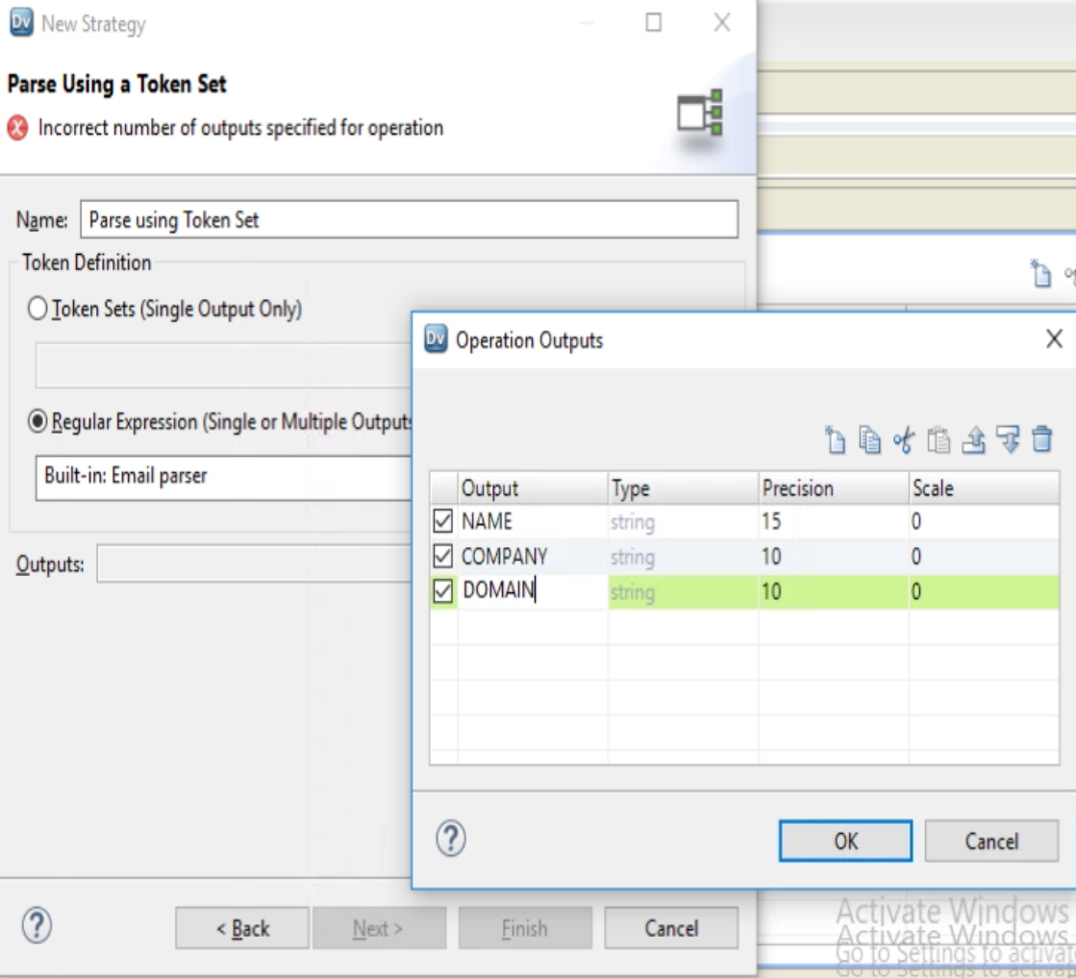
Step 5 : Configure PARSER TRANSFORMATION
A . SELECT Regular Expression ➔ CHOOSE Email Parser
B. Regular Expression : EMAIL Parser = Builtin
C. Create New output ➔ Click NEW
D. Three NEW Output column NAME, COMPANY and DOMAIN

Slide 10
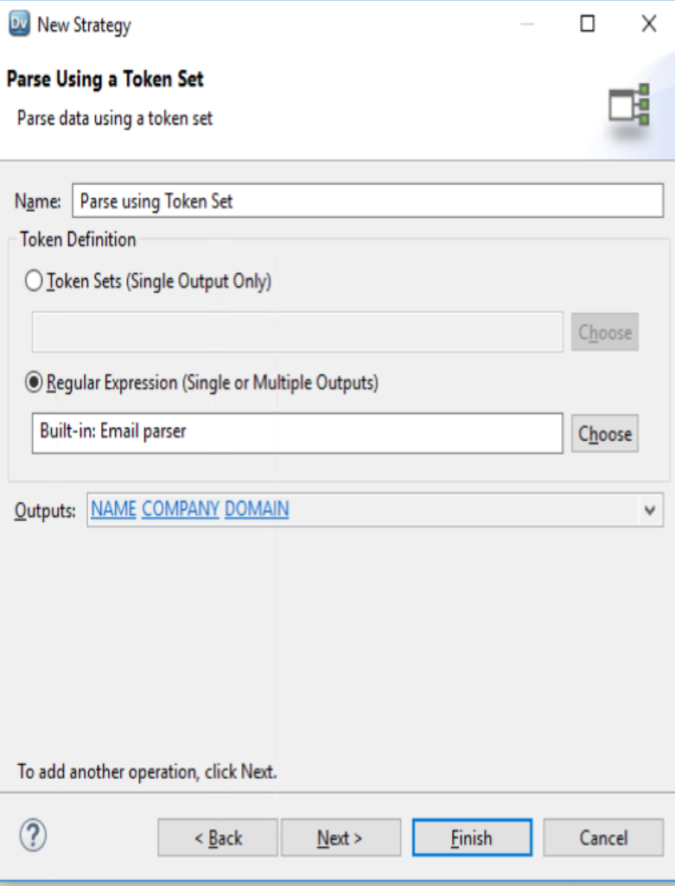
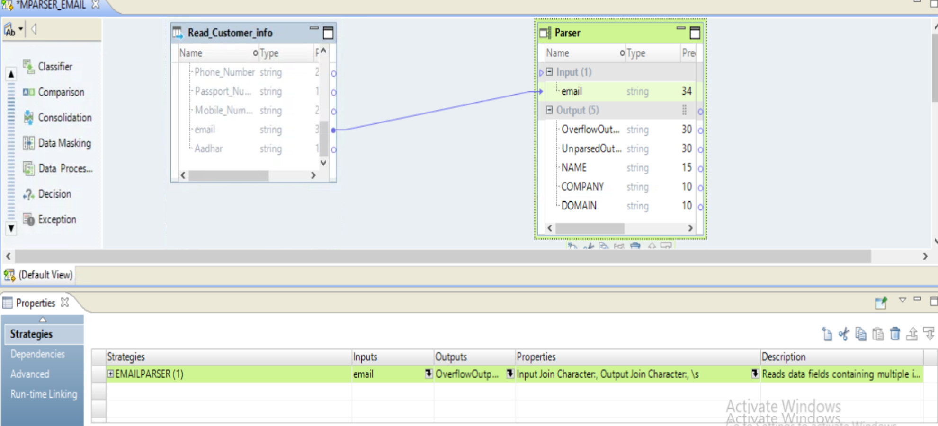
Step 6 : Configure PARSER TRANSFORMATION
A Choose Finish
Complete Parser Transformation

Slide 11
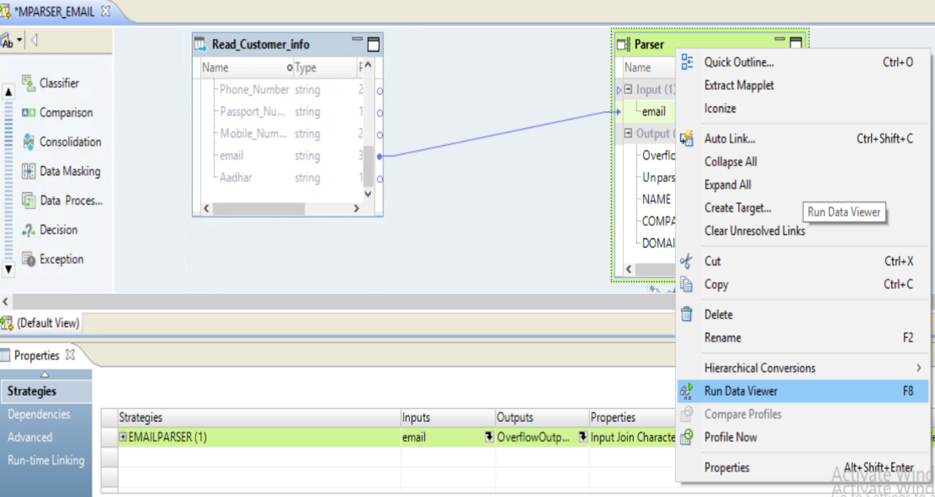
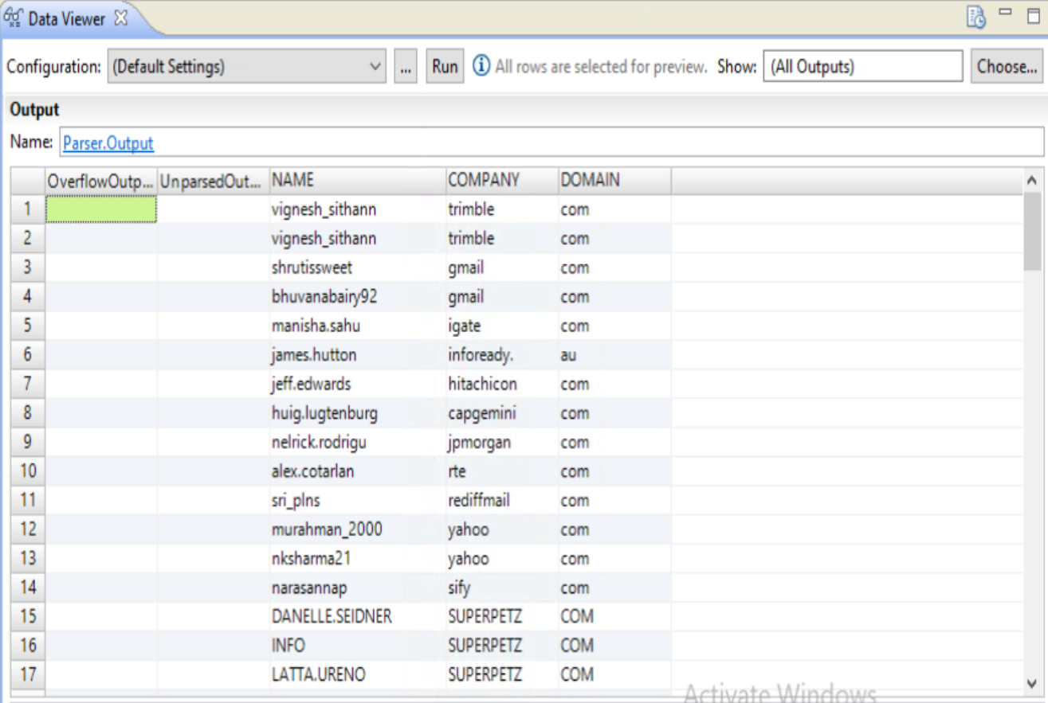
Step 7 : Run Data Viewer

Slide 12
Informatica Data Quality Parser Transformation – Regular Expression

Slide 17
Add Parser Transformation and Link Input Port from Read_TESTREGEX

